Slide 1
E-Learning System
Like any other project, a web site begins as a concept. The website has purposes providing the information about E-Learning System. The goal is to spread information about the brief knowledge about Networking Components. The goal is very broad, such as creating an online presence to build name recognition and Prestige for a city website and making sure to work out right approach I plan to take in achieving that goal.

Slide 2
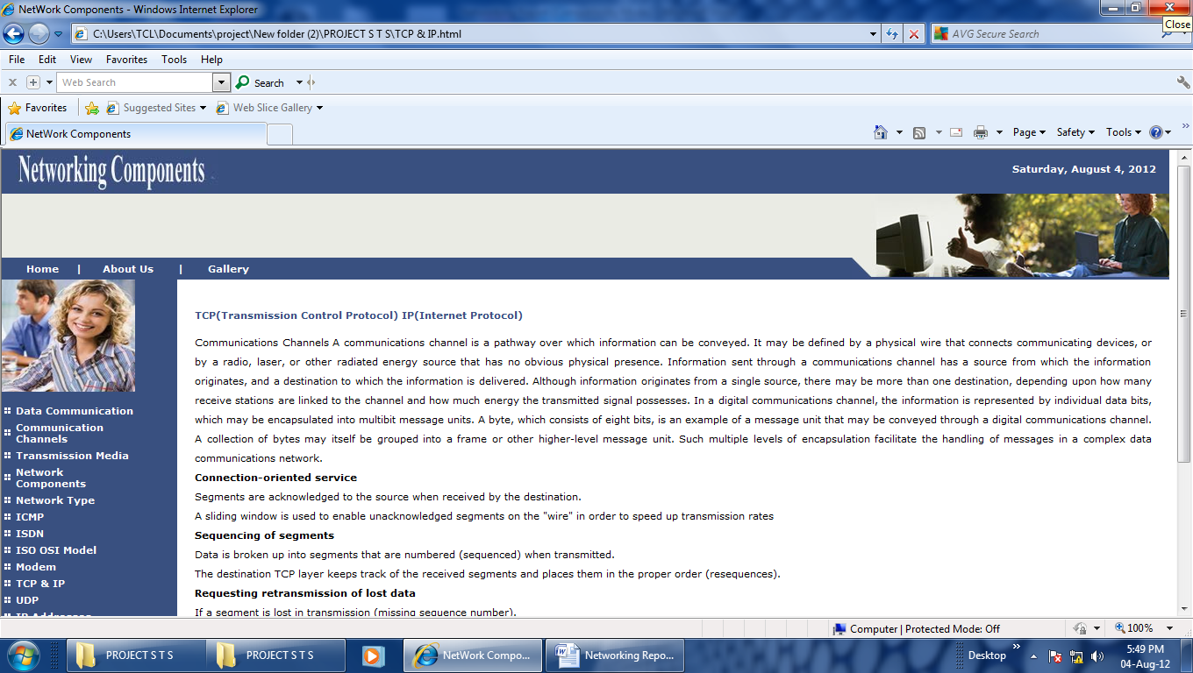
E-Learning System

Slide 3
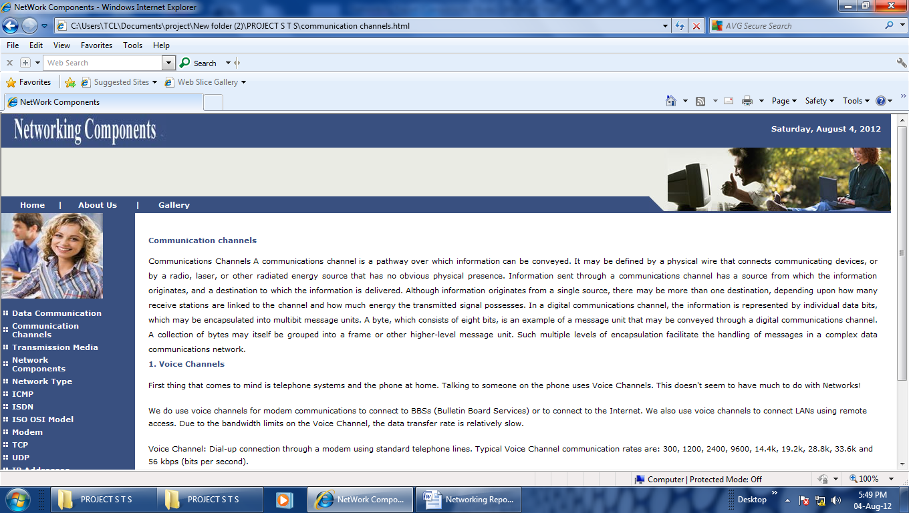
E-Learning System

Slide 4
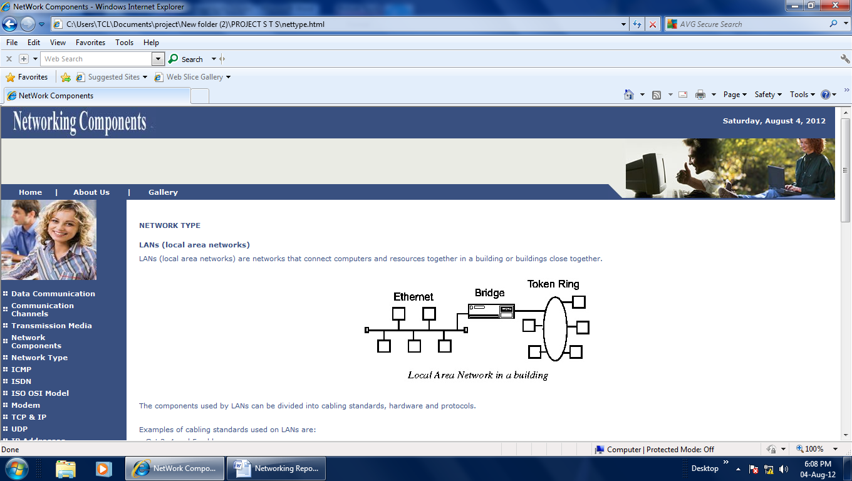
E-Learning System

Slide 5
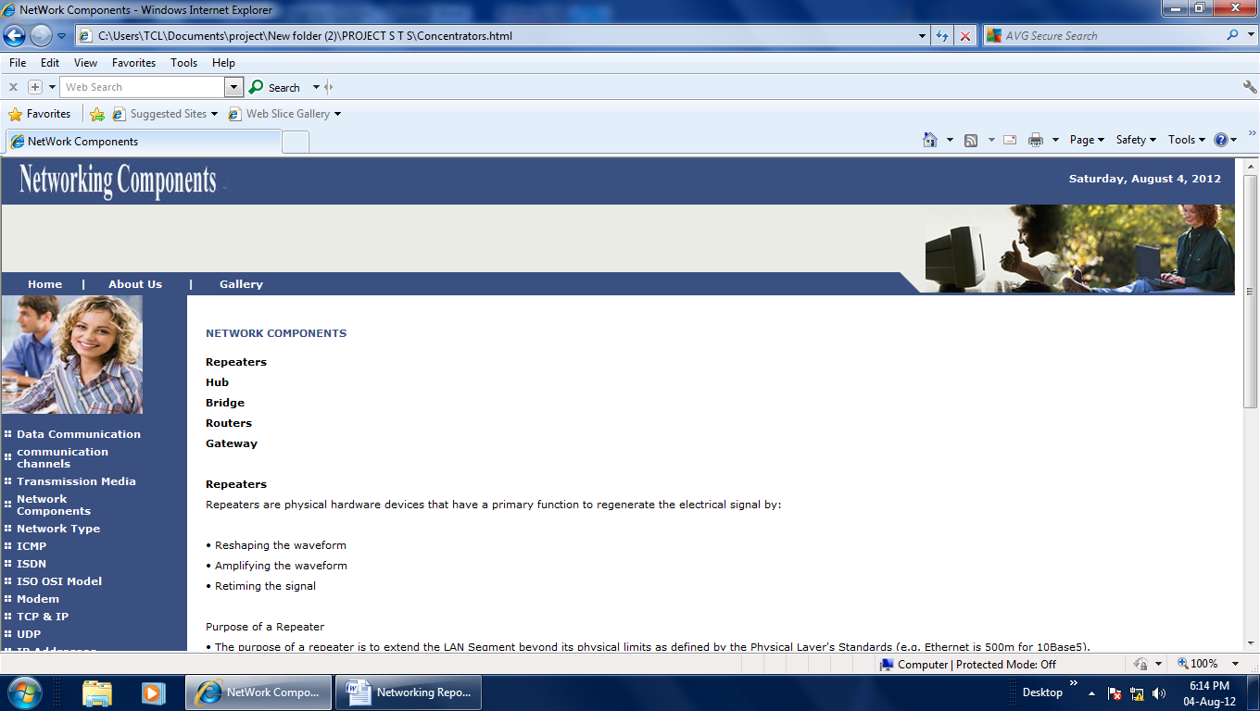
E-Learning System

Slide 6
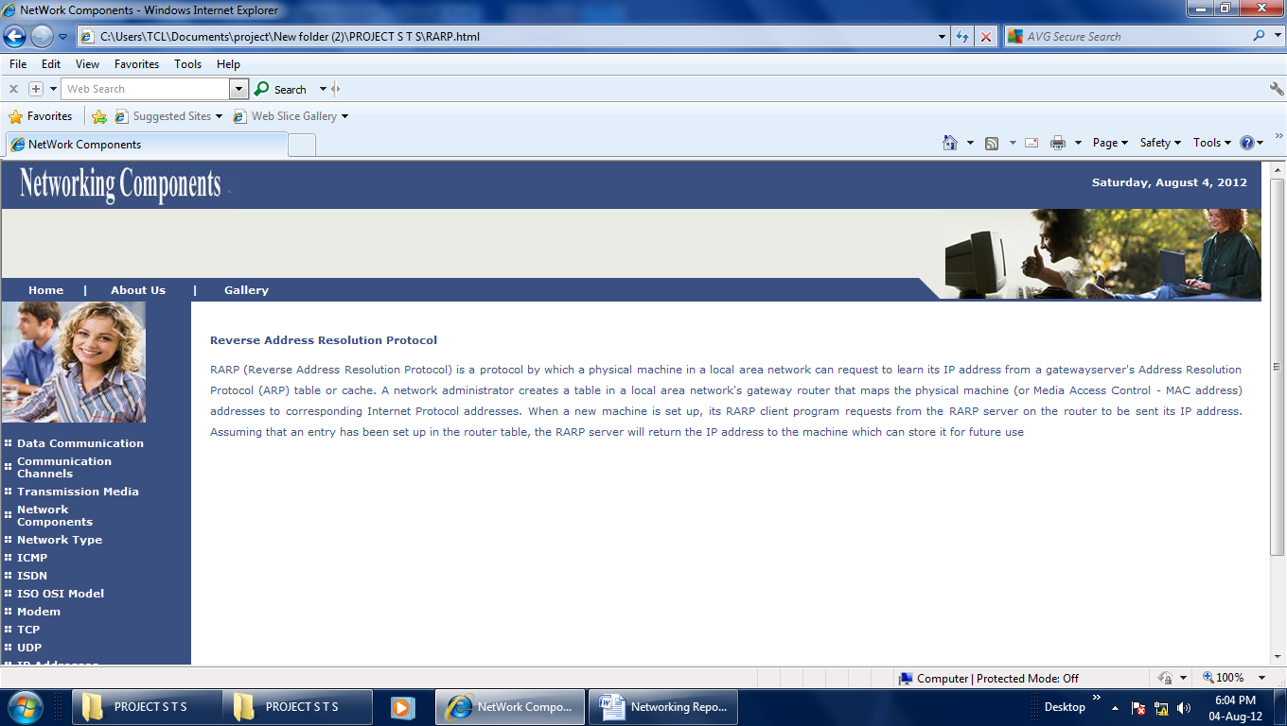
E-Learning System

Slide 7
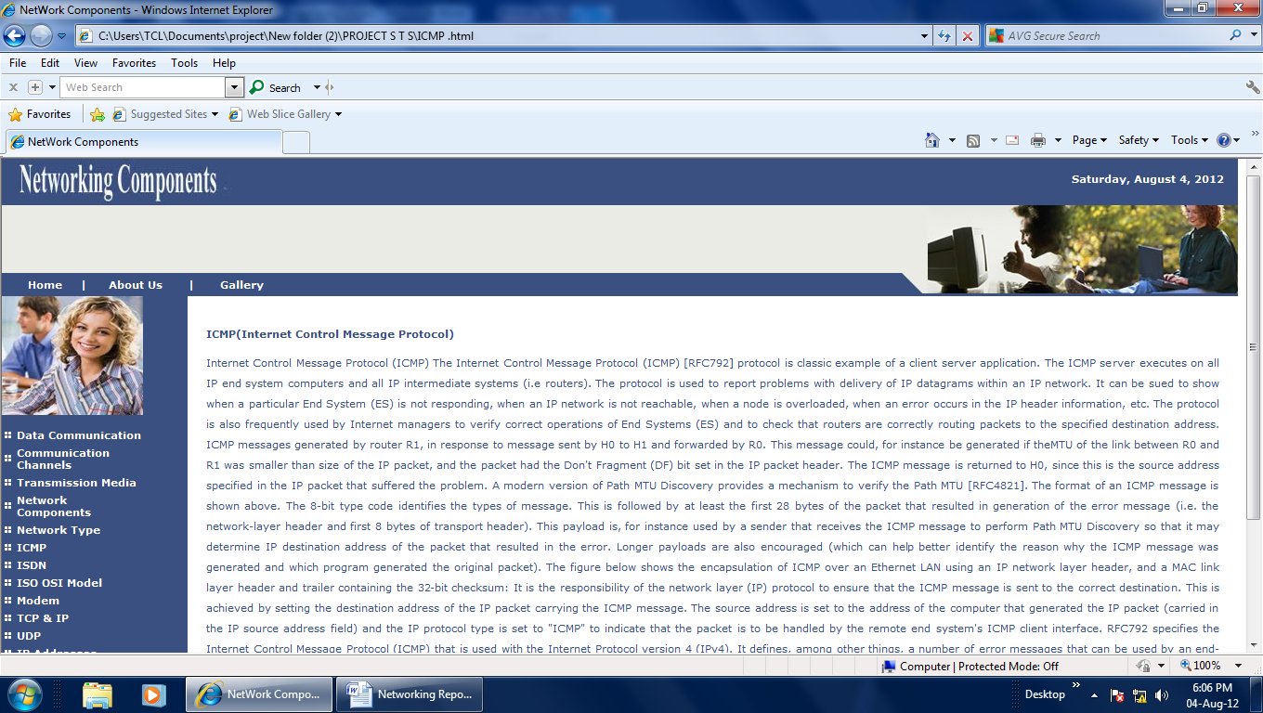
E-Learning System

Slide 8

E-Learning System

Slide 9
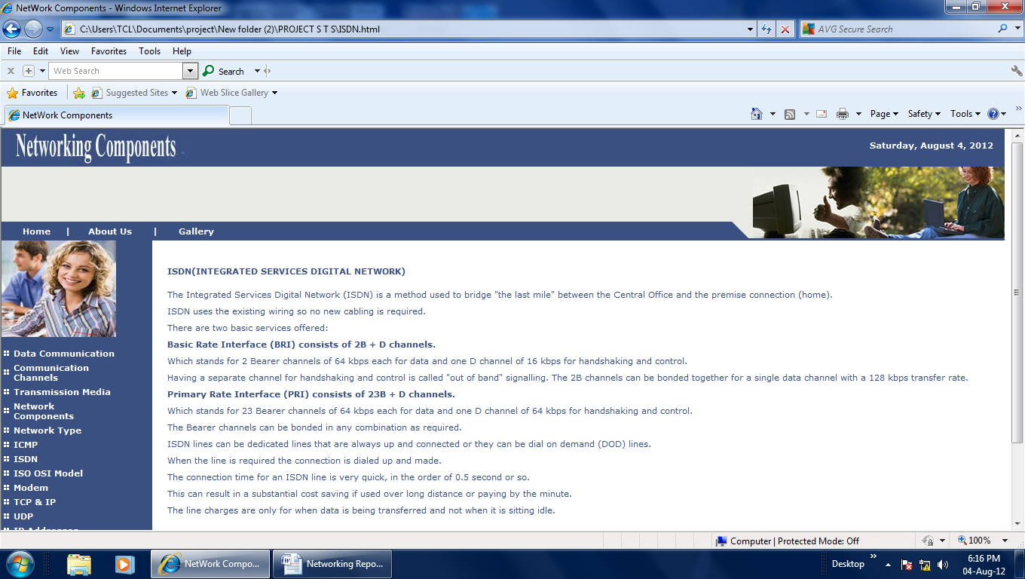
E-Learning System

Slide 10
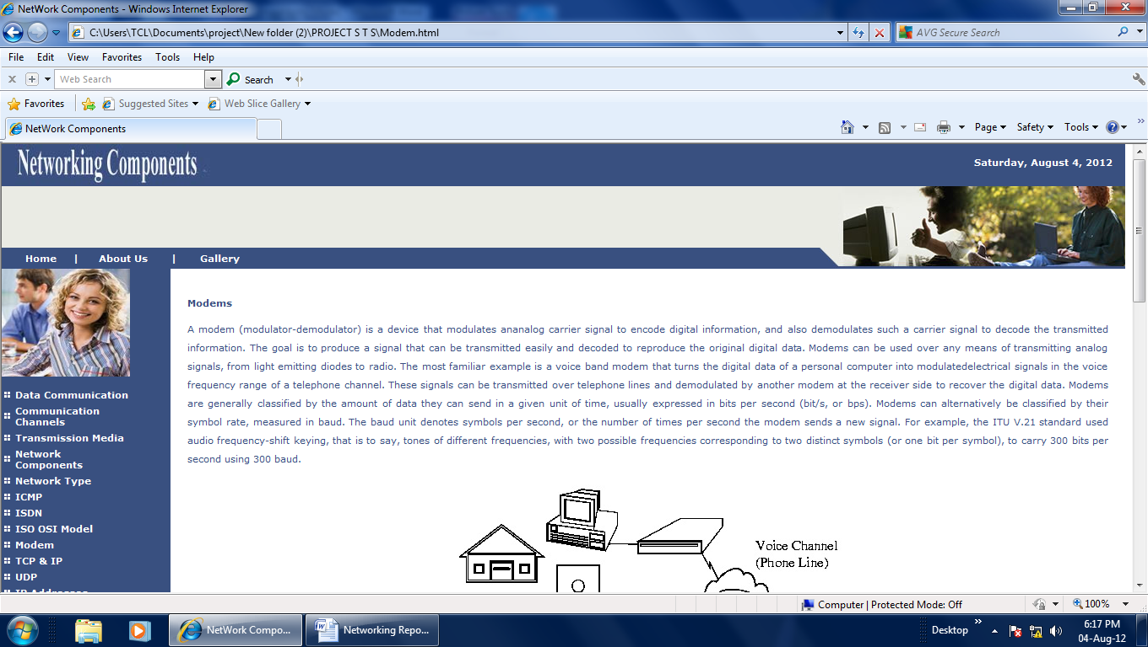
E-Learning System

Slide 11
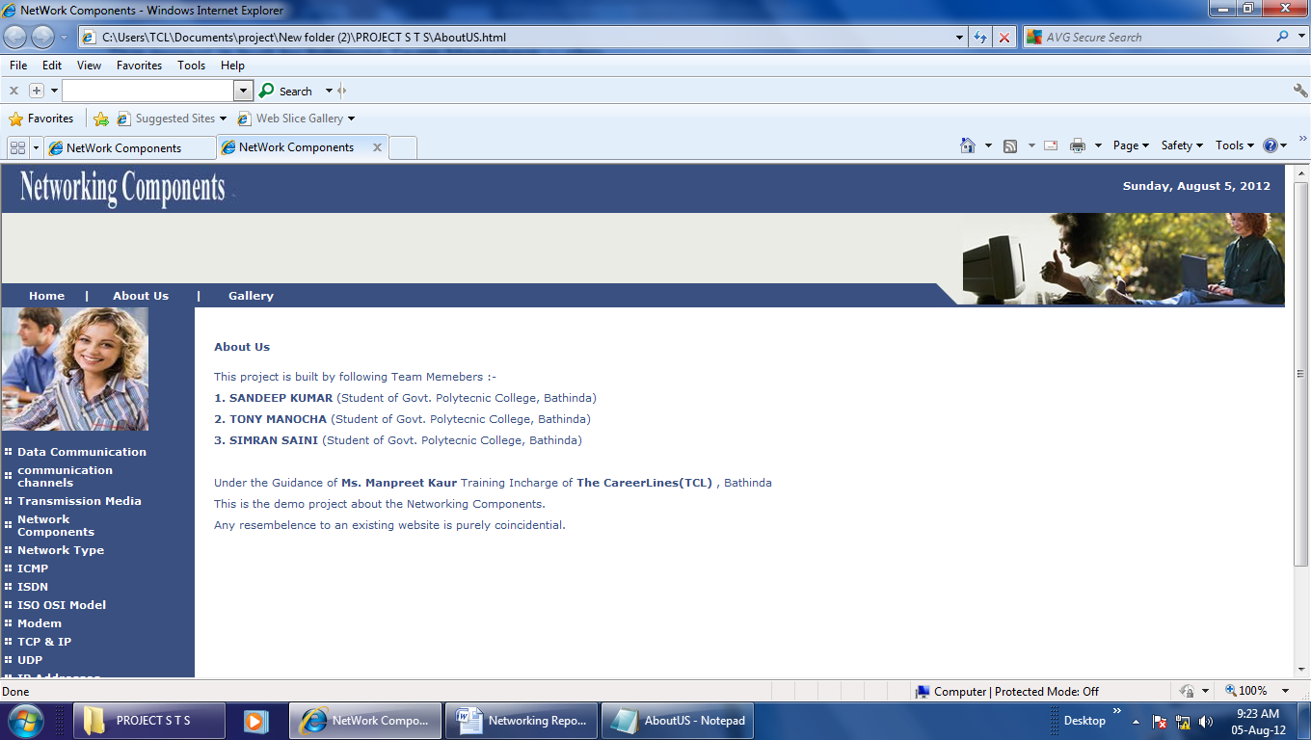
E-Learning System

Slide 12
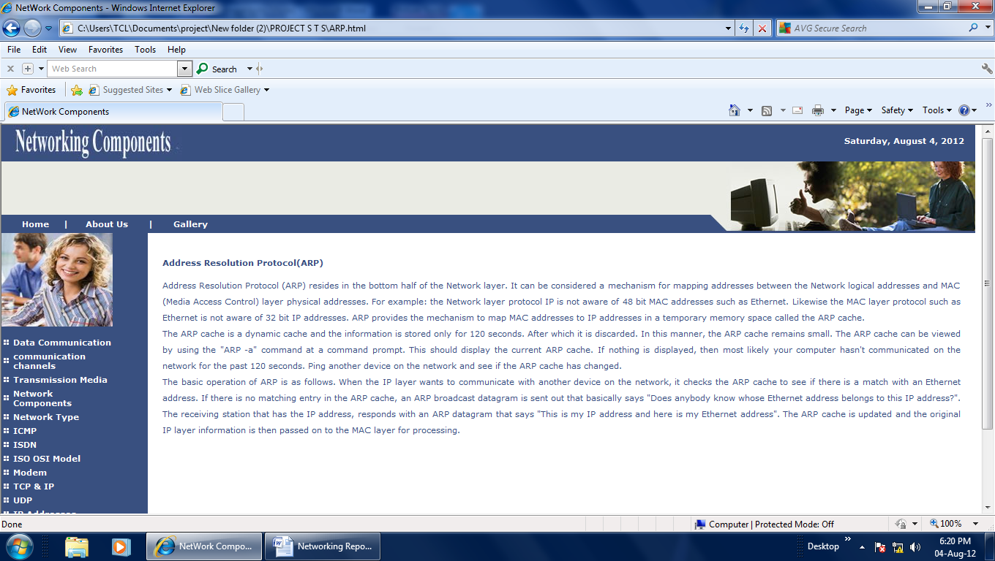
E-Learning System

Slide 13
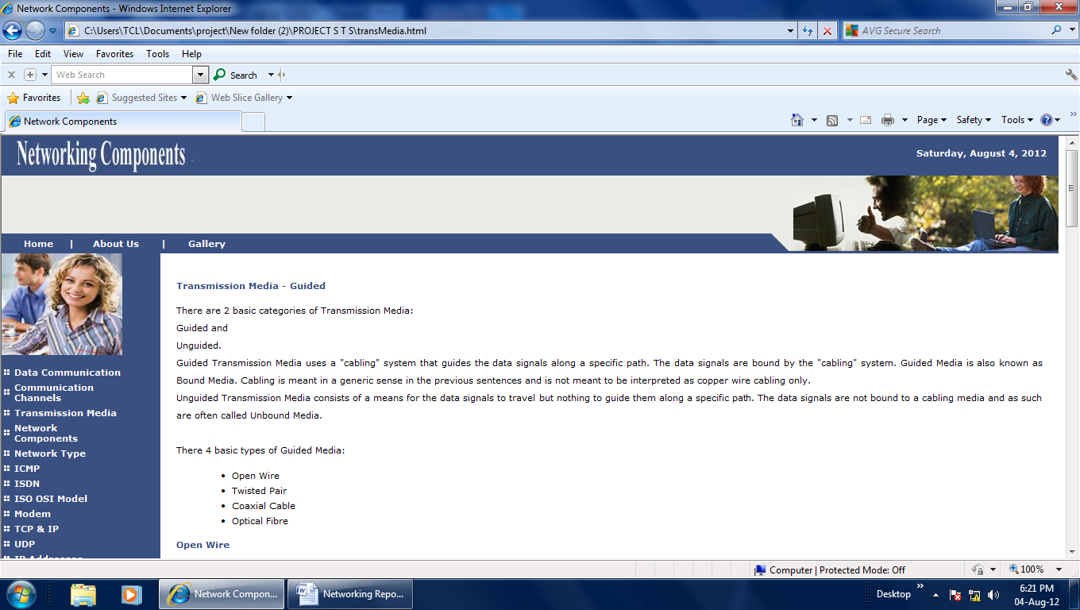
E-Learning System

Slide 14
E-Learning System
BIBLIOGRAPHY
WEBSITES
www.yahoo.com
www.google.com
BOOKS
ISHAN’s Publication
IPH
Encyclopedia

